Slide 1
Euler’s Method
Solution to Differential Equations
mathkanection.com

Slide 2
Who is Euler?
Pronounced “Oy-ler”, not “You-ler.”
Swiss mathematician, physicist, astronomer, geographer, logician, and engineer.
1707 - 1783
Introduced $π$ for Archimedes constant, the ratio of the circumference of a circle to its diameter.
Developed the mathematical constant, $e$.
Received math lessons from Johann Bernoulli (we’ll find out about him in Unit 8).
mathkanection.com

Slide 3
What is Euler’s Method?
Numerical approach to approximate the solution to a differential equation
Approximates the solution curve using line segments (tangent line segments…like in slope fields).
Repeated use of tangent line approximation to approximate the solution to the differential equation.
mathkanection.com

Slide 4
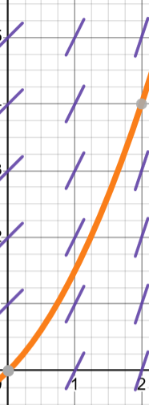
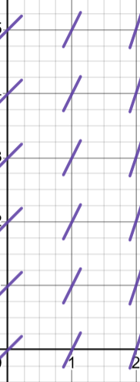
How does Euler’s Method work?
Given $\frac{dy}{dx}=x+1$ and $y\left(0\right)=0$, use Euler’s method with increments of $1$ to approximate the value of $y\left(2\right)$.
Solving the differential equation would get…
$$y={\frac{1}{2}x}^{2}+x$$
Then, the exact value is:
$y\left(2\right)=4$
mathkanection.com

Slide 5
How does Euler’s Method work?
Given $\frac{dy}{dx}=x+1$ and $y\left(0\right)=0$, use Euler’s method with increments of $1$ to approximate the value of $y\left(2\right)$.
Recall: tangent line approximation
$$y(2)≈2$$
$$y−y_{1}=m\left(x−x_{1}\right)$$
$$y−y_{1}=\frac{dy}{dx}(∆x)$$
$$y=y_{1}+\frac{dy}{dx}(∆x)$$
mathkanection.com

Slide 6
How does Euler’s Method work?
Given $\frac{dy}{dx}=x+1$ and $y\left(0\right)=0$, use Euler’s method with increments of $1$ to approximate the value of $y\left(2\right)$.
Euler uses multiple tangent lines
Better approximation
Tangent line using next point
Tangent line using initial point $(0,0)$
mathkanection.com

Slide 7
How does Euler’s Method work?
Given $\frac{dy}{dx}=x+1$ and $y\left(0\right)=0$, use Euler’s method with increments of $1$ to approximate the value of $y\left(2\right)$.
mathkanection.com

Slide 8
Example 1:
Consider the differential equation $\frac{dy}{dx}=y^{2}\left(2x+2\right)$. Let $y=f(x)$ be the particular solution to the differential equation with initial condition $f\left(0\right)=−1$.
Use Euler’s method, starting at $x=0$with two steps of equal size, to approximate $f\left(\frac{1}{2}\right)$.
mathkanection.com

Slide 9
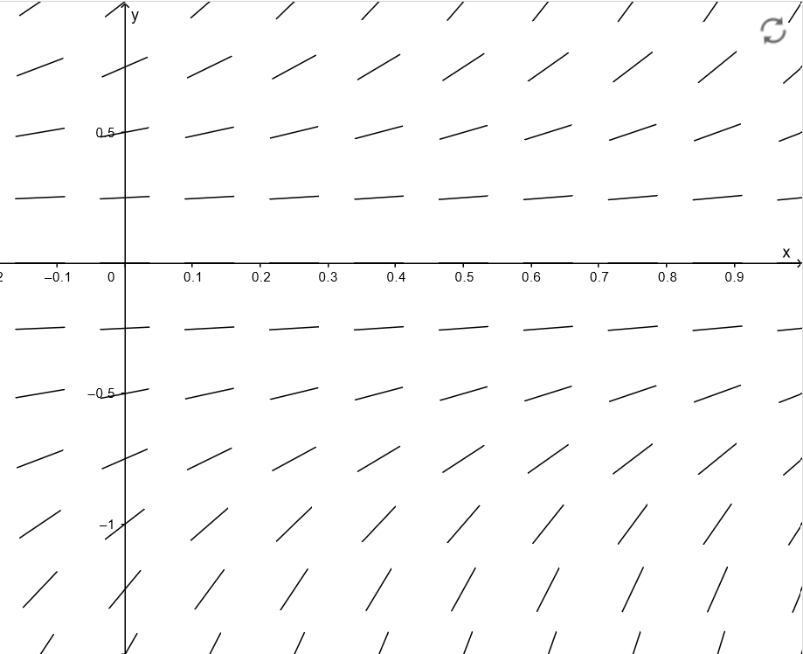
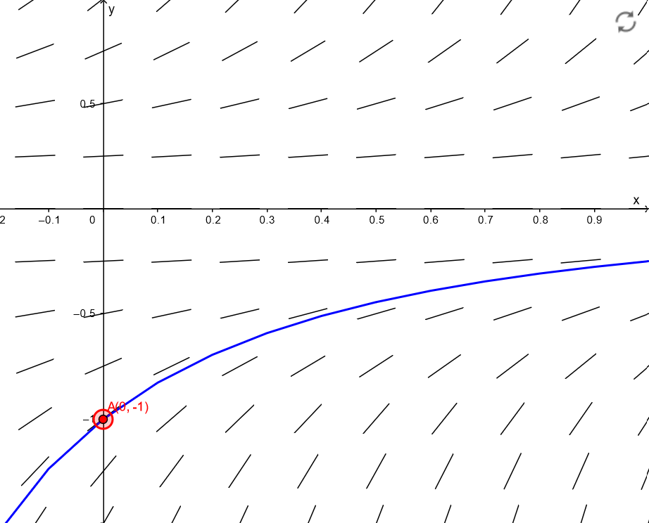
Example 1:
Consider the differential equation $\frac{dy}{dx}=y^{2}\left(2x+2\right)$. Let $y=f(x)$ be the particular solution to the differential equation with initial condition $f\left(0\right)=−1$.
Use Euler’s method, starting at $x=0$with two steps of equal size, to approximate $f\left(\frac{1}{2}\right)$.
mathkanection.com

Slide 10
Example 2:
The function f is twice differentiable for x > 0 with $f\left(1\right)=15$ and $f^{′′}\left(1\right)=20$. Values of $f′$, the derivative of f , are given for selected values of x in the table below.
$$x$$ | $$1$$ | $$1.1$$ | $$1.2$$ | $$1.3$$ | $$1.4$$
$$f′(x)$$ | $$8$$ | $$10$$ | $$12$$ | $$13$$ | $$14.5$$
Use Euler’s method, starting at x = 1 with two steps of equal size, to approximate $f\left(1.4\right)$. Show the computations that lead to your answer.
mathkanection.com

Slide 11
Euler’s Method
Solution to Differential Equations
mathkanection.com

