Slide 1
Slope Fields
Sketching & Matching Slope Fields
mathkanection.com

Slide 2
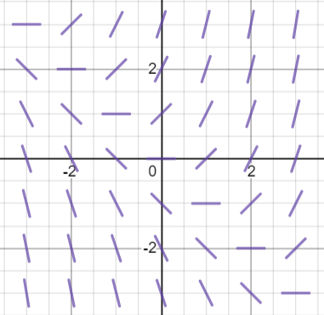
Sample Slope Field
Recall that a Slope Field is a graphical representation of each of the slopes that we find at points all over the plane by a short line segment that is actually as steep as the slope says it should be at that point.
Example: $\frac{dy}{dx}=x+y$
mathkanection.com

Slide 3
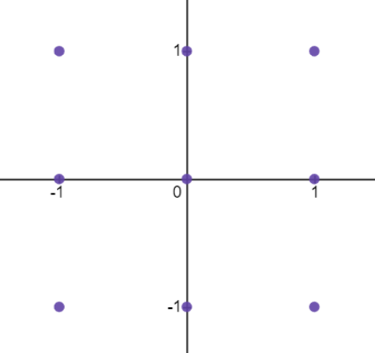
Sketch a Slope Field
Make a table from given points to record the slope values.
Example: Sketch a slope field for the differential equation, $\frac{dy}{dx}=2x$,
at the nine points given.
mathkanection.com

Slide 4
Sketch a Slope Field
Make a table from given points to record the slope values.
Example: Sketch a slope field for the differential equation, $\frac{dy}{dx}=2x$,
at the nine points given.
mathkanection.com

Slide 5
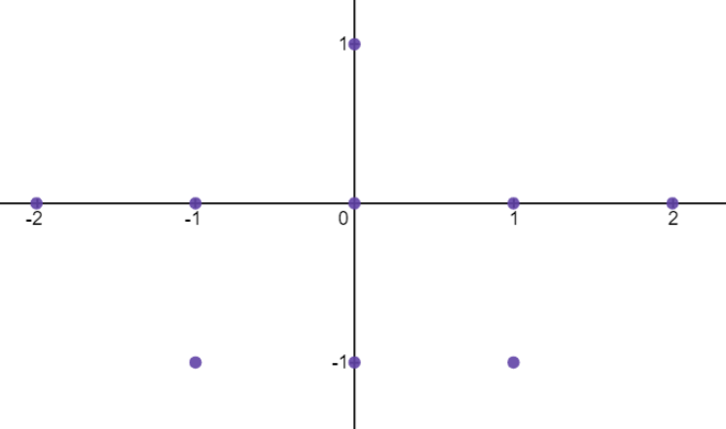
Sketch a Slope Field
Make a table from given points to record the slope values.
Example: Sketch a slope field for the differential equation, $\frac{dy}{dx}=2x−y$,
at the points given.
mathkanection.com

Slide 6
Matching Slope Fields w/Differential Equations
Look for slopes that:
① equal zero
② are the same along the $x$-axis (this is when $y=0$)
③ are the same along the $y$-axis (this is when $x=0$)
depend only on the $x$-values (this means that the slopes only change
when the $x$-value changes…you see the same slopes vertically)
⑤ depend only on the $y$-values (this means that the slopes only change
when the $y$-value changes…you see the same slopes vertically)
⑥ are all positive OR all negative
mathkanection.com

Slide 7
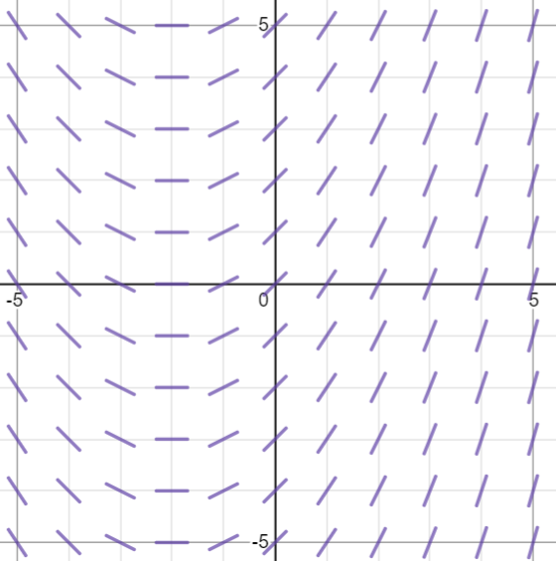
Matching Slope Fields w/Differential Equations
Look for slopes that:
① equal zero
mathkanection.com

Slide 8
Matching Slope Fields w/Differential Equations
Look for slopes that:
② are the same along the $x$-axis (this is when $y=0$)
mathkanection.com

Slide 9
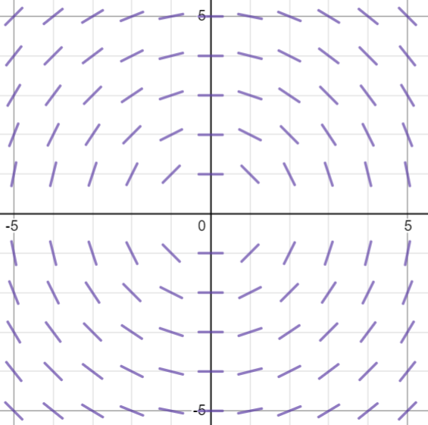
Matching Slope Fields w/Differential Equations
Look for slopes that:
③ are the same along the $y$-axis (this is when $x=0$)
mathkanection.com

Slide 10
Matching Slope Fields w/Differential Equations
Look for slopes that:
depend only on the $x$-values (this means that the slopes only change
when the $x$-value changes…you see the same slopes vertically)
mathkanection.com

Slide 11
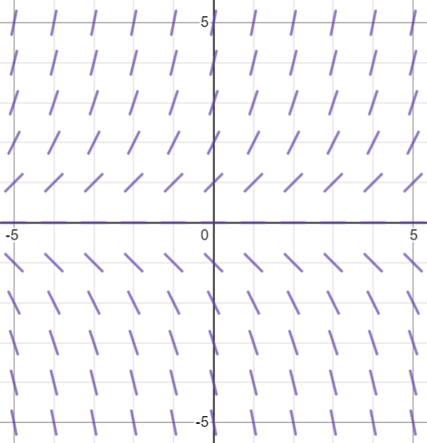
Matching Slope Fields w/Differential Equations
Look for slopes that:
⑤ depend only on the $y$-values (this means that the slopes only change
when the $y$-value changes…you see the same slopes horizontally)
mathkanection.com

Slide 12
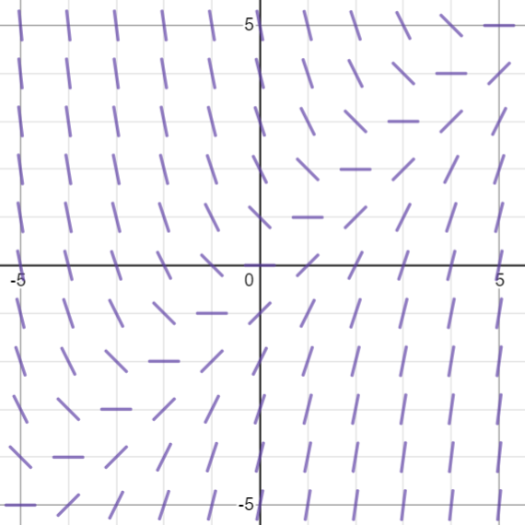
Matching Slope Fields w/Differential Equations
Look for slopes that:
⑥ are all positive OR all negative
mathkanection.com

Slide 13
Matching Slope Fields w/Differential Equations
(A) (B) (C) (D)
1. $\frac{dy}{dx}=\frac{1}{2}x+1$ 2. $\frac{dy}{dx}=y$ 3. $\frac{dy}{dx}=x−y$ 4. $\frac{dy}{dx}=−\frac{x}{y}$
mathkanection.com

Slide 14
Slope Fields
Sketching & Matching Slope Fields
mathkanection.com

