Slide 1
Slope Fields
Solutions to Differential Equations
mathkanection.com

Slide 2
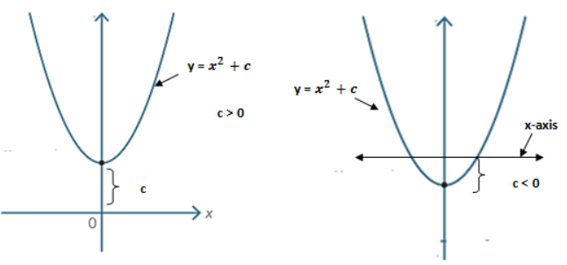
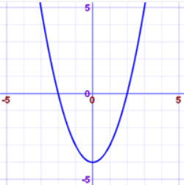



What is a Slope Field?
A graphical way to represent the general solutions to the differential equation and to find a particular, graphical solution to the differential equation.
Sample Diff’ Eq: $\frac{dy}{dx}=2x$
General Solution:
$$y=x^{2}+C$$
Particular Solution through $(2,0)$:
$y=x^{2}−4$
mathkanection.com

Slide 3

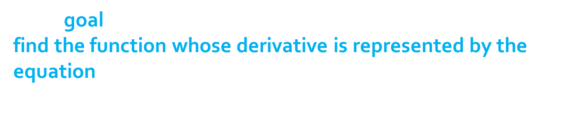
Why don’t we just solve the Diff’ Eq?
If our goal when we are given a differential equation is to
find the function whose derivative is represented by the equation (that is, if our goal is to find $y$),
why don’t we just integrate & find $y$?
Unfortunately, integration isn't something we will always be able to use. Many (most?) differential equations can't be integrated directly.
Example: $\frac{dy}{dx}=x+y$
mathkanection.com

Slide 4

So What Does a Slope Field Look Like?
A graphical representation of each of the slopes that we find at points all over the plane by a short line segment that is actually as steep as the slope says it should be at that point.
We can think of these little line segments as tangent lines to the function $y$ that we are looking for.
We call the resulting picture a slope field, or direction field.
mathkanection.com

Slide 5
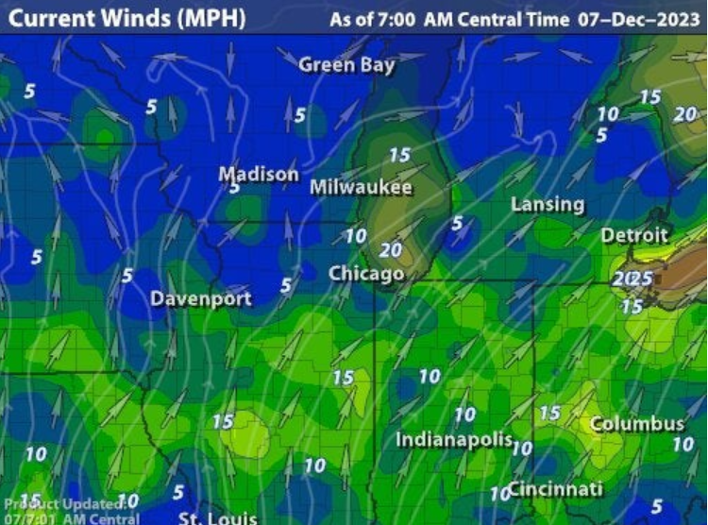
Real-Life Slope Field: Wind Patterns
mathkanection.com

Slide 6
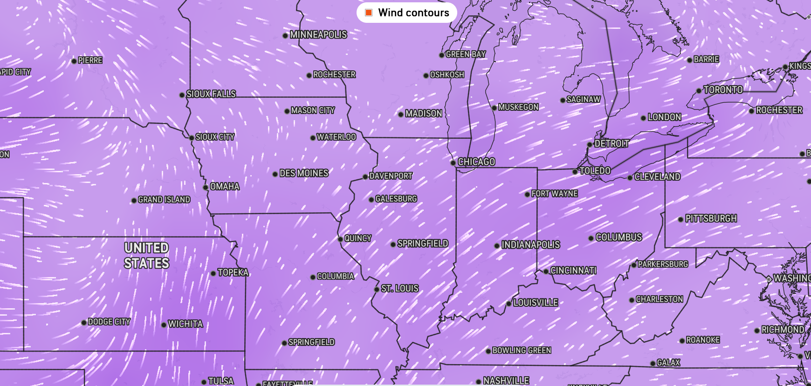
Real-Life Slope Field: Wind Patterns
mathkanection.com

Slide 7
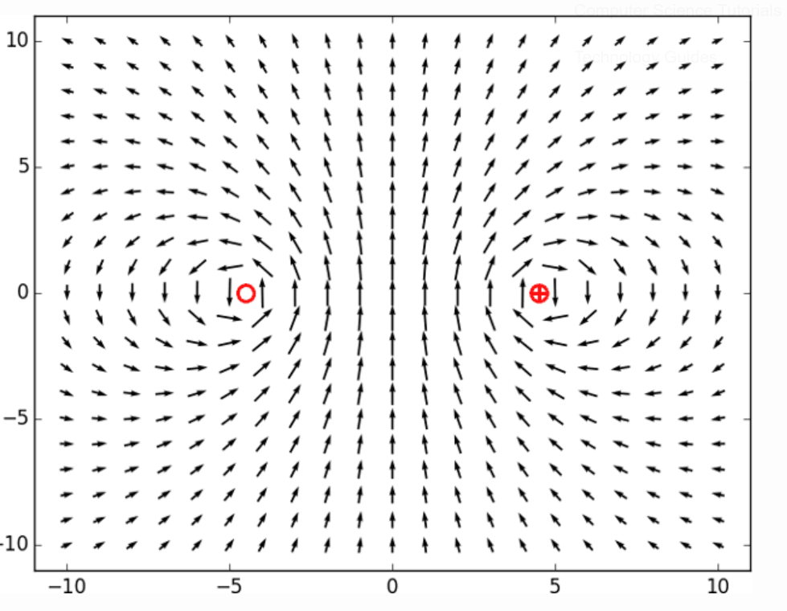
Real-Life Slope Field: Magnetic Fields
mathkanection.com

Slide 8
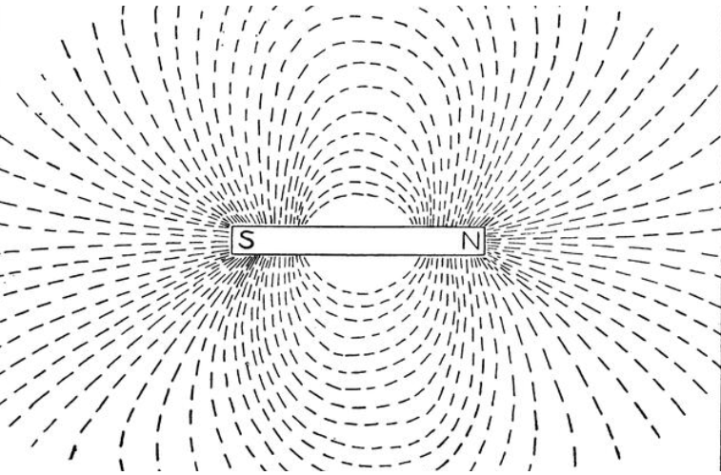
Real-Life Slope Field: Magnetic Fields
Watch Magnet Experiments
mathkanection.com

Slide 9
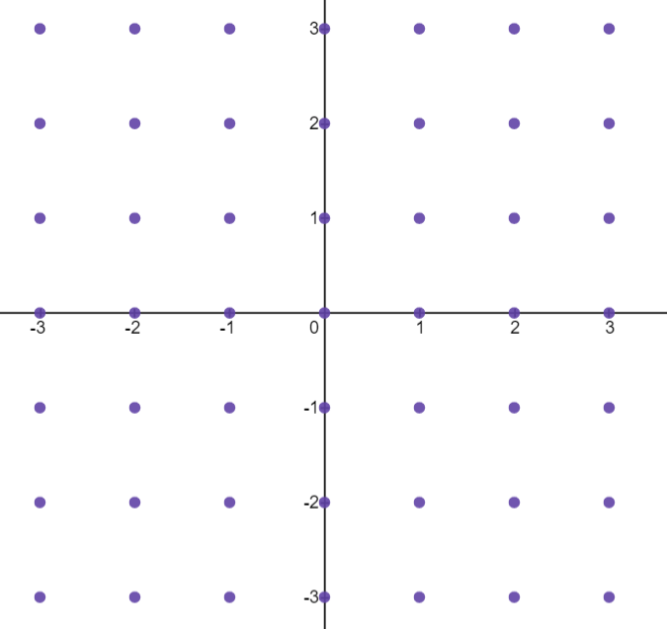




So What Does a Slope Field Look Like?
$$\frac{dy}{dx}=x+y$$
Example:
Let's examine a few selected points.
At the point $(1,2)$,
the slope would be $1+2= 3$.
At the point $(−3,3)$,
the slope would be $−3+3= 0$.
At the point $(−2,−3)$,
the slope would be $−2+ −3=−5$.
mathkanection.com

Slide 10
So What Does a Slope Field Look Like?
We would need to calculate the slopes for the entire plane
…impossible!
…the ENTIRE INFINITE PLANE
So, we will just calculate for a reasonable number of points.
mathkanection.com

Slide 11
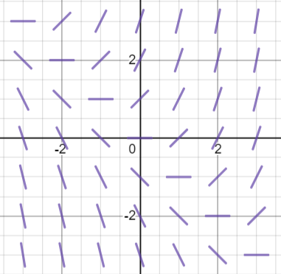


So What Does a Slope Field Look Like?
Slope field for select points on $[−3,3]$by $[−3,3]$.
$$\frac{dy}{dx}=x+y$$
Example:
mathkanection.com

Slide 12
Why are we looking at Slope Fields?
Our goal when we are given a differential equation is to find the function whose derivative is represented by the equation.
Although we can’t solve the differential equation, we CAN sketch the solution to the differential equation.
mathkanection.com

Slide 13
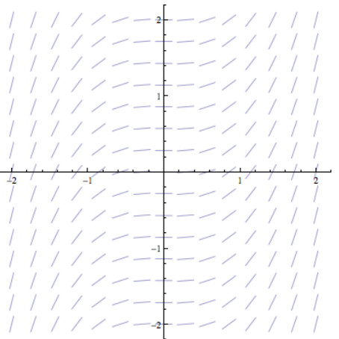

Solution to a Differential Equation
Sketch the particular solution to the differential equation passing through $(0,1)$.
mathkanection.com

Slide 14

Solution to a Differential Equation
Sketch the particular solution to the differential equation passing through $(0,−1)$.
mathkanection.com

Slide 15
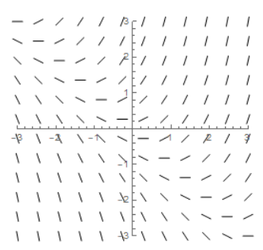
Solution to a Differential Equation
Sketch the particular solution to the differential equation passing through $(0,1)$.
mathkanection.com

Slide 16

Solution to a Differential Equation
Sketch the particular solution to the differential equation passing through $(0,−1)$.
mathkanection.com

Slide 17
Slope Fields
Solutions to Differential Equations
mathkanection.com

