Slide 1
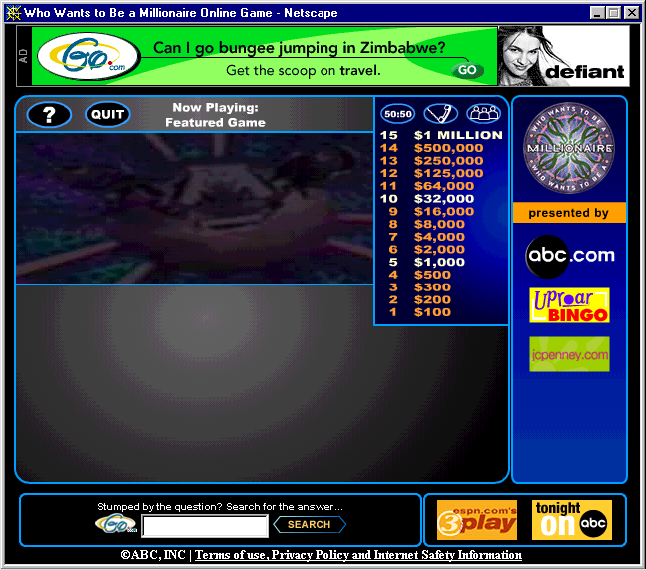
Who Wants to Be a Millionaire?

Slide 2
Area Btn Curves & Volume of a Solid
_________________________
_____________________
_____________________
_____________________
___________________
___________________
__________________
_________________
_________________
_________________
_________________
______________
______________
______________
______________
Click the appropriate dollar amount at right to proceed to the question

Slide 3
Phone A Friend
“OK Contestant…Please select a friend to help you with this one. You have thirty seconds to discuss your options…”
Return to the Question

Slide 4
Ask the Audience
“Audience, we need your help on this one…in a moment, we’ll ask you to indicate, by show of hands, your choice for the correct answer…”
Return to the Question

Slide 5
Fifty - Fifty
50/50
You’ve asked that two of the wrong answers be eliminated, leaving you with one wrong answer plus the correct one.
Return to the Question

Slide 6
Correct
Correct!
Proceed to Next Question

Slide 7
Incorrect
Sorry, That’s Incorrect
Return to the Question

Slide 8

Question #1... This food represents the volume of a solid connected to the $x$-axis and revolved about the $x$-axis.
50/50
Cookies
Orange
A
B
Fruit Roll-Up
Life Saver
C
D

Slide 9
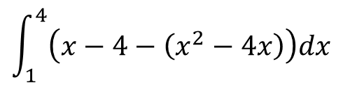
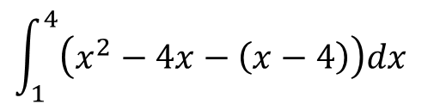

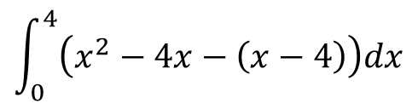
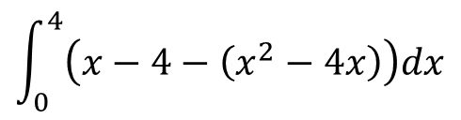
Question #2... Find the area of the region bounded by the graphs of $y=x2 –4x$and
$y=x–4$.
50/50
$$\int_{0}^{4}{\left(x−4−\left(x^{2}−4x\right)\right)dx}$$
$$\int_{1}^{4}{\left(x^{2}−4x−\left(x−4\right)\right)dx}$$
A
B
C
$$\int_{0}^{4}{\left(x^{2}−4x−\left(x−4\right)\right)dx}$$
D
$$\int_{1}^{4}{\left(x−4−\left(x^{2}−4x\right)\right)dx}$$

Slide 10
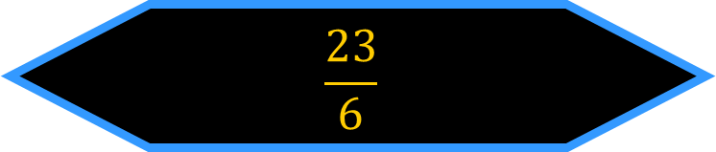

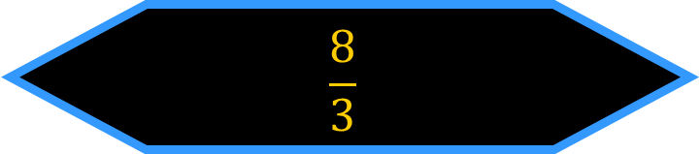
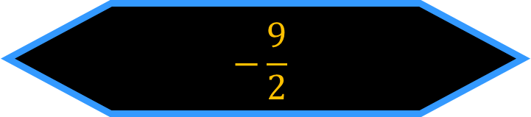
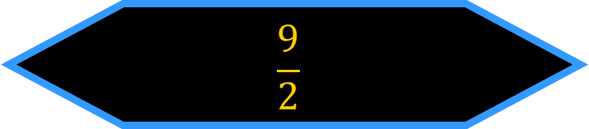
Question #3... Find the area of the region bounded by the graphs of $y=x2 –4x$ and
$y=x –4$.
50/50
$$−\frac{9}{2}$$
$$\frac{23}{6}$$
A
B
$$\frac{9}{2}$$
$$\frac{8}{3}$$
C
D

Slide 11

Question #4... What food do you think of when finding the volume of the region formed by $f(x)=3x2$and $g(x)=5x+2$ revolved about the $x$-axis?
50/50
Life Saver
Oranges
A
B
Pizza
Fruit Roll-ups
C
D

Slide 12
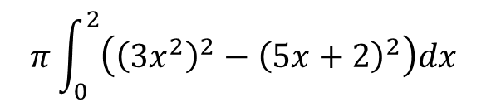
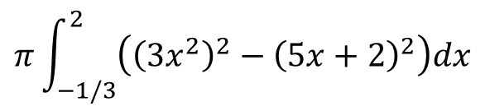
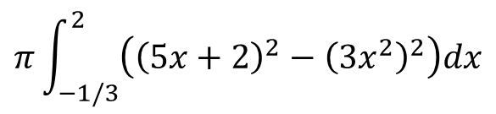

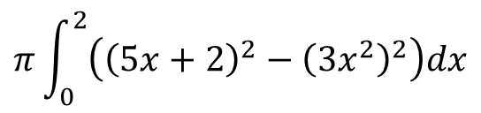
Question #5... Find the volume of the region formed by
$f(x)=3x2$and $g(x)=5x+2$ revolved about the $x$-axis.
50/50
$$π\int_{0}^{2}{\left({\left(5x+2\right)}^{2}−{\left({3x}^{2}\right)}^{2}\right)dx}$$
$$π\int_{−1/3}^{2}{\left({\left(5x+2\right)}^{2}−{\left({3x}^{2}\right)}^{2}\right)dx}$$
A
B
C
$$π\int_{−1/3}^{2}{\left({\left(3x^{2}\right)}^{2}−{\left(5x+2\right)}^{2}\right)dx}$$
D
$$π\int_{0}^{2}{\left({\left(3x^{2}\right)}^{2}−{\left(5x+2\right)}^{2}\right)dx}$$

Slide 13
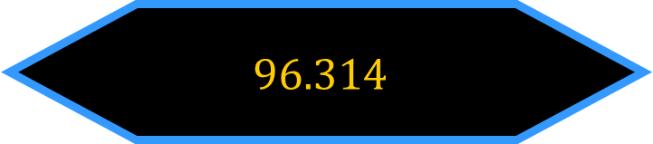

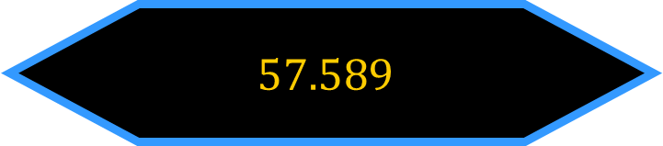
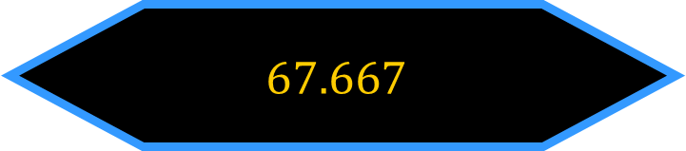

Question #6... Find the volume of the region formed by
$f(x)=3x2$ and $g\left(x\right)=5x+2$ revolved about the $x$-axis.
50/50
$$57.589$$
$$67.667$$
A
B
$$96.314$$
$$180.925$$
C
D

Slide 14

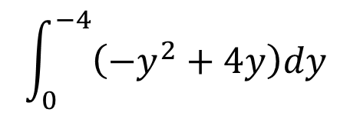



Question #7... Find the area of the region bounded by the graphs of $x=y2+4y$and $x=0$.
50/50
$$\int_{−4}^{0}{\left(y^{2}+4y\right)dy}$$
$$\int_{0}^{−4}{\left(−y^{2}+4y\right)dy}$$
A
B
$$\int_{−4}^{0}{\left(−y^{2}−4y\right)dy}$$
$$\int_{0}^{−4}{\left(y^{2}−4y\right)dy}$$
C
D

Slide 15
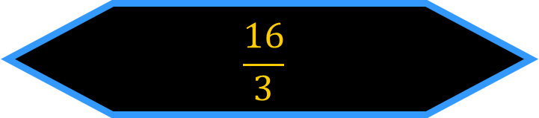

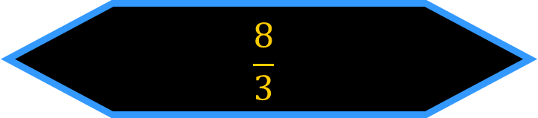
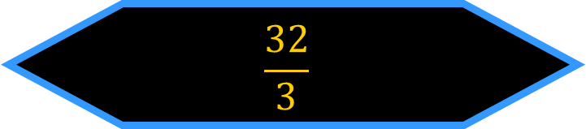
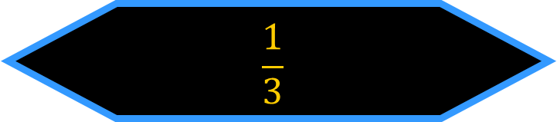
Question #8... Find the area of the region bounded by the graphs of $x=y2+4y$and $x=0$.
50/50
$$\frac{8}{3}$$
$$\frac{32}{3}$$
A
B
$$\frac{16}{3}$$
$$\frac{1}{3}$$
C
D

Slide 16
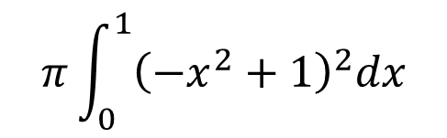
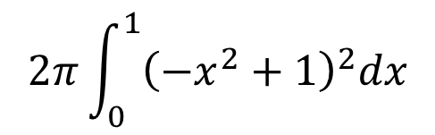
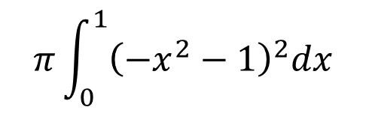

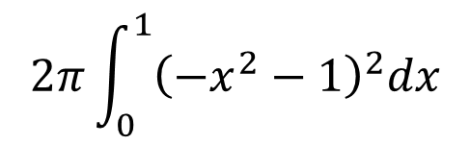
Question #9... Find the volume of the solid formed by revolving the region bounded by the graphs of $y=−x2+ 1$and $y=0$about the $x$-axis.
50/50
$$2π\int_{0}^{1}{{\left(−x^{2}−1\right)}^{2}dx}$$
$$π\int_{0}^{1}{{\left(−x^{2}+1\right)}^{2}dx}$$
A
B
$$π\int_{0}^{1}{{\left(−x^{2}−1\right)}^{2}dx}$$
$$2π\int_{0}^{1}{{\left(−x^{2}+1\right)}^{2}dx}$$
C
D

Slide 17

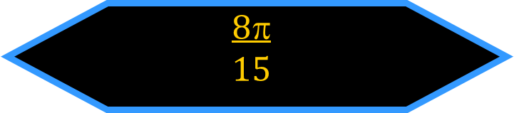
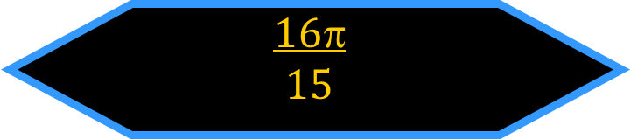
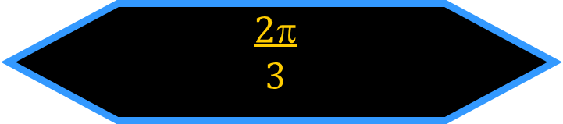
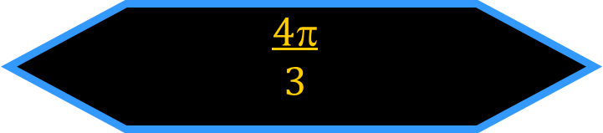
Question #10... Find the volume of the solid formed by revolving the region bounded by the graphs of $y = −x2 + 1$and $y = 0$about the $x$-axis.
50/50
$$16$$
$$15$$
$$8$$
$$15$$
A
B
$$4$$
$$3$$
$$2$$
$$3$$
C
D

Slide 18
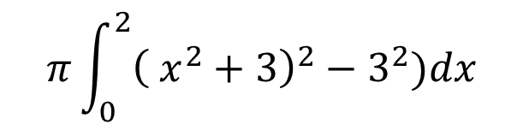
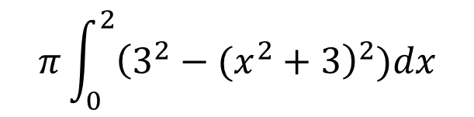
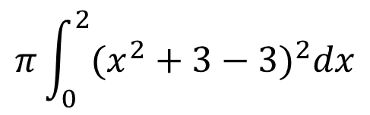

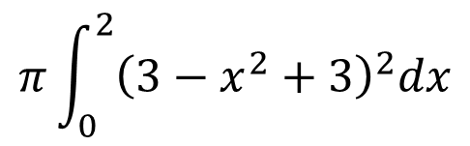
Question #11... Find the volume of the solid formed by revolving the region bounded by the graphs of
$y=x2+3$, $y=3$, $x=0$ and $x=2$ about the line $y=3$.
50/50
$$π\int_{0}^{2}{{\left(3−x^{2}+3\right)}^{2}dx}$$
$$π\int_{0}^{2}{{(x^{2}+3−3)}^{2}dx}$$
A
B
$$π\int_{0}^{2}{{\left(3^{2}−(x^{2}+3\right)}^{2})dx}$$
$$π\int_{0}^{2}{{\left( x^{2}+3\right)}^{2}−3^{2})dx}$$
C
D

Slide 19
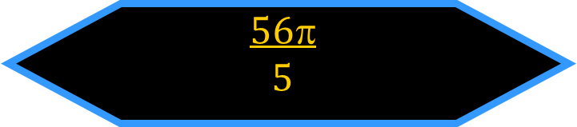


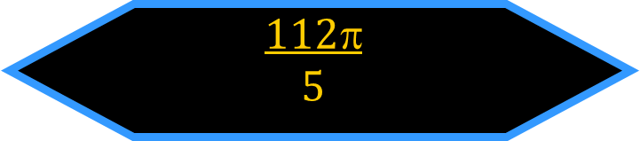
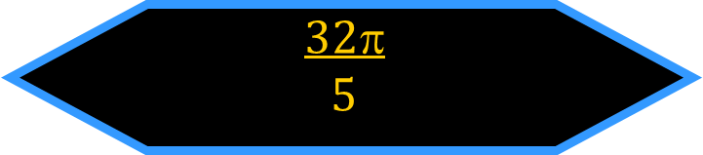
Question #12... Find the volume of the solid formed by revolving the region bounded by the graphs of
$y=x2+3$, $y=3$, $x=0$ and $x=2$ about the line $y=3$.
50/50
$$64$$
$$5$$
$$112$$
$$5$$
A
B
$$56$$
$$5$$
$$32$$
$$5$$
C
D

Slide 20

Question #13... Which volume formula does not use $$?
50/50
Square Cross Sections
Washer Method
A
B
Disk Method
Semi-circle Cross Sections
C
D

Slide 21
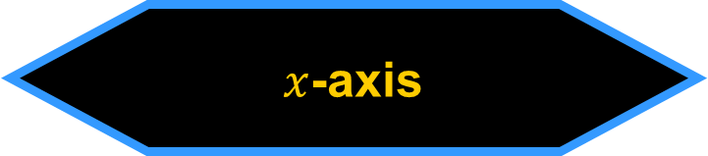

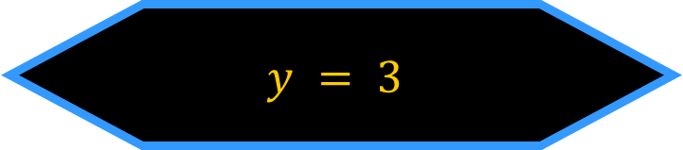

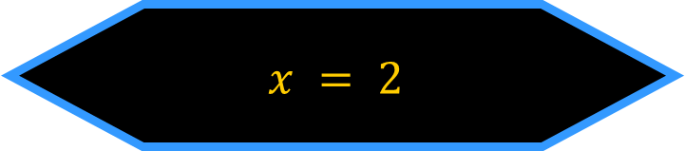
Question #14... What would the region of the graphs of $y=x2$, $x=0$and $y=2$revolve about to in order to use the disk method?
50/50
$$y = 3$$
$$y = 2$$
A
B
$x$-axis
$$x = 2$$
C
D

Slide 22

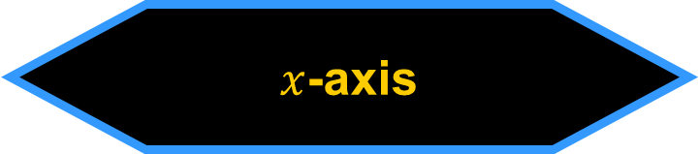
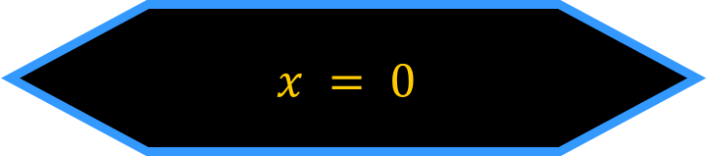
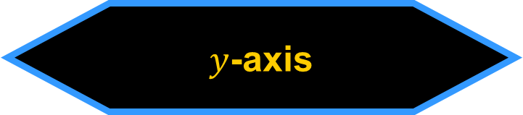
Question #15... What would the region of the graphs of $y=x2$, $x=0$and $y=2$ revolve about to in order to use the washer method?
50/50
$x$-axis
$$y = 2$$
A
B
$y$-axis
$$x = 0$$
C
D

